Slide 1
Lecture # 1 (Final) Serial Communications Interfaces

Slide 2
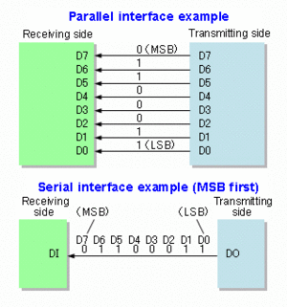
Data Transmission
Data transmission can be performed two ways.
Parallel Communications, where several bits of data are transmitted/ received, on a link with several parallel channels.
Serial Communications, where data is transmitted/ received bit by bit through a single channel.

Slide 3
Serial Data Communication
Advantage of serial communication:
Smaller number of communication lines is required compared to parallel communication.
2 lines (transmit & receive) are required in asynchronous full duplex serial comm.
3 lines (transmit, receive & clock) are required in synchronous serial communication.
Less interference & higher reliability: Serial communication uses fewer wires, so there is almost no issue with noise, crosstalk, or signal skew between lines—making it more stable for long-distance data transfer.
Cheaper and simpler hardware: With only one data line (plus ground), serial communication requires fewer pins, less cabling, and simpler connectors—reducing cost and making the design easier.
Disadvantage of serial communication:
More time is required to transmit/receive compared to parallel communication.

Slide 4
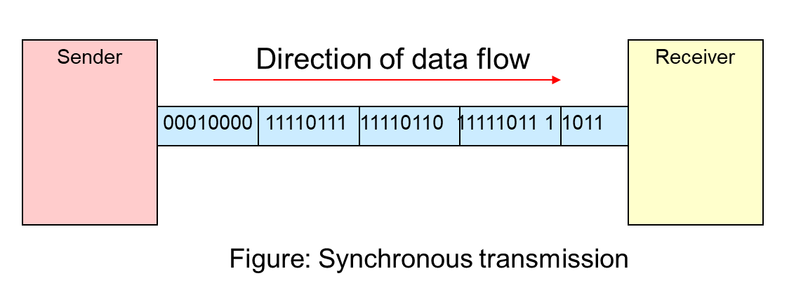
Synchronous transmission
In synchronous transmission, bits are sent one after another without start or stop bits or gaps. It is the responsibility of the receiver to group the bits.
Synchronous transmission is a data transmission method where data is sent in a continuous stream along with a clock signal to synchronize the sender and receiver.
Example: Transferring files between computers using a USB or Ethernet connection is a real-world example of synchronous transmission.

Slide 5
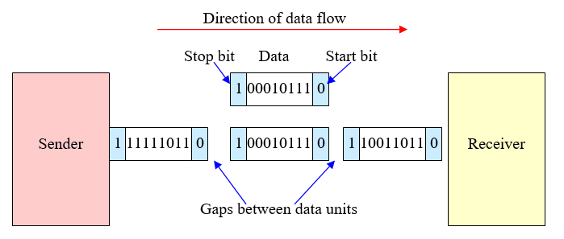
Asynchronous transmission
In asynchronous transmission, one start bit (0) at the beginning, followed by a byte and one or two stop bits (1) at the end of each byte. There may be a gap between each byte. This is also known as framing.
Generally use in low speed data transmission.
Send one start bit (0) at beginning of the byte and one or two stop bits (1) at end of each byte.
There are variable–length gaps between each byte.
Asynchronous transmission is a method of data communication in which data is sent one character or byte at a time, with start and stop bits used to indicate the beginning and end of each character, allowing the receiver to identify when new data begins.
Keyboard to computer communication (via serial port): Each keystroke sends a character using asynchronous transmission.

Slide 6
Types of Serial Communication
ATmega328 has 3 types of serial communication interfaces:
1. Universal Synchronous Asynchronous Receiver & Transmitter (USART).
2. Serial Peripheral Interface (SPI).
3. Two Wire Interface (TWI)/ Inter-Integrated Circuit (I2C).

Slide 7
USART vs. UART
 | UART | USART
Full Name | Universal Asynchronous Receiver/Transmitter | Universal Synchronous/Asynchronous Receiver/Transmitter
Data type and rate | It generates asynchronous data, hence has low data rate. | It generates clocked/synchronous data, hence has higher data rate.
Baud rate | Receiver need to know baud rate of the transmitter before communication to be established so that UART can generate clock internally and synchronize it with data stream with the help of transition of start bit. | Receiver need not be required to know the baud rate of the transmitter. This is derived from the clock signal and data line.
Data Structure | It uses start bit (before data word), stop bits (one or two, after data word), parity bit (even or odd) in its base format for data formatting. | USART can also generate data like UART. Hence USART can be used as UART, but reverse is not possible.
Protocol | UART is simple protocol to generate data. | USART is complex and uses many different protocols to generate the data for transmissions.

Slide 8
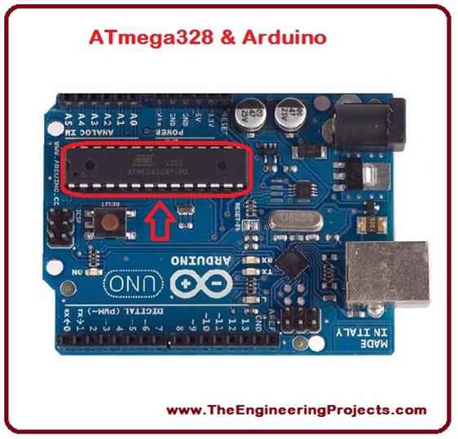
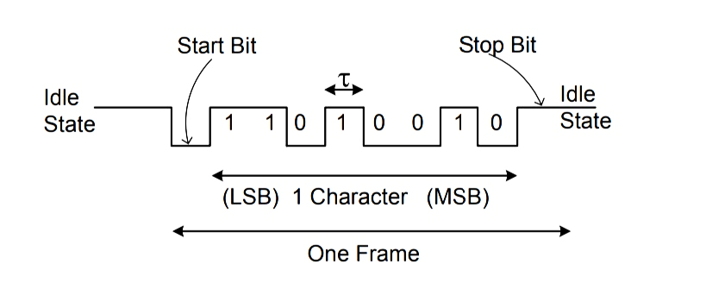
UART/USART
It is an asynchronous/synchronous serial communication.
It uses 2 pins in Port D:
1. TXD/PD1 – The serial data transmission line.
2. RXD/PD0 – The serial data reception line.
Data is transmitted/received in a serial frame as follows:

Slide 9
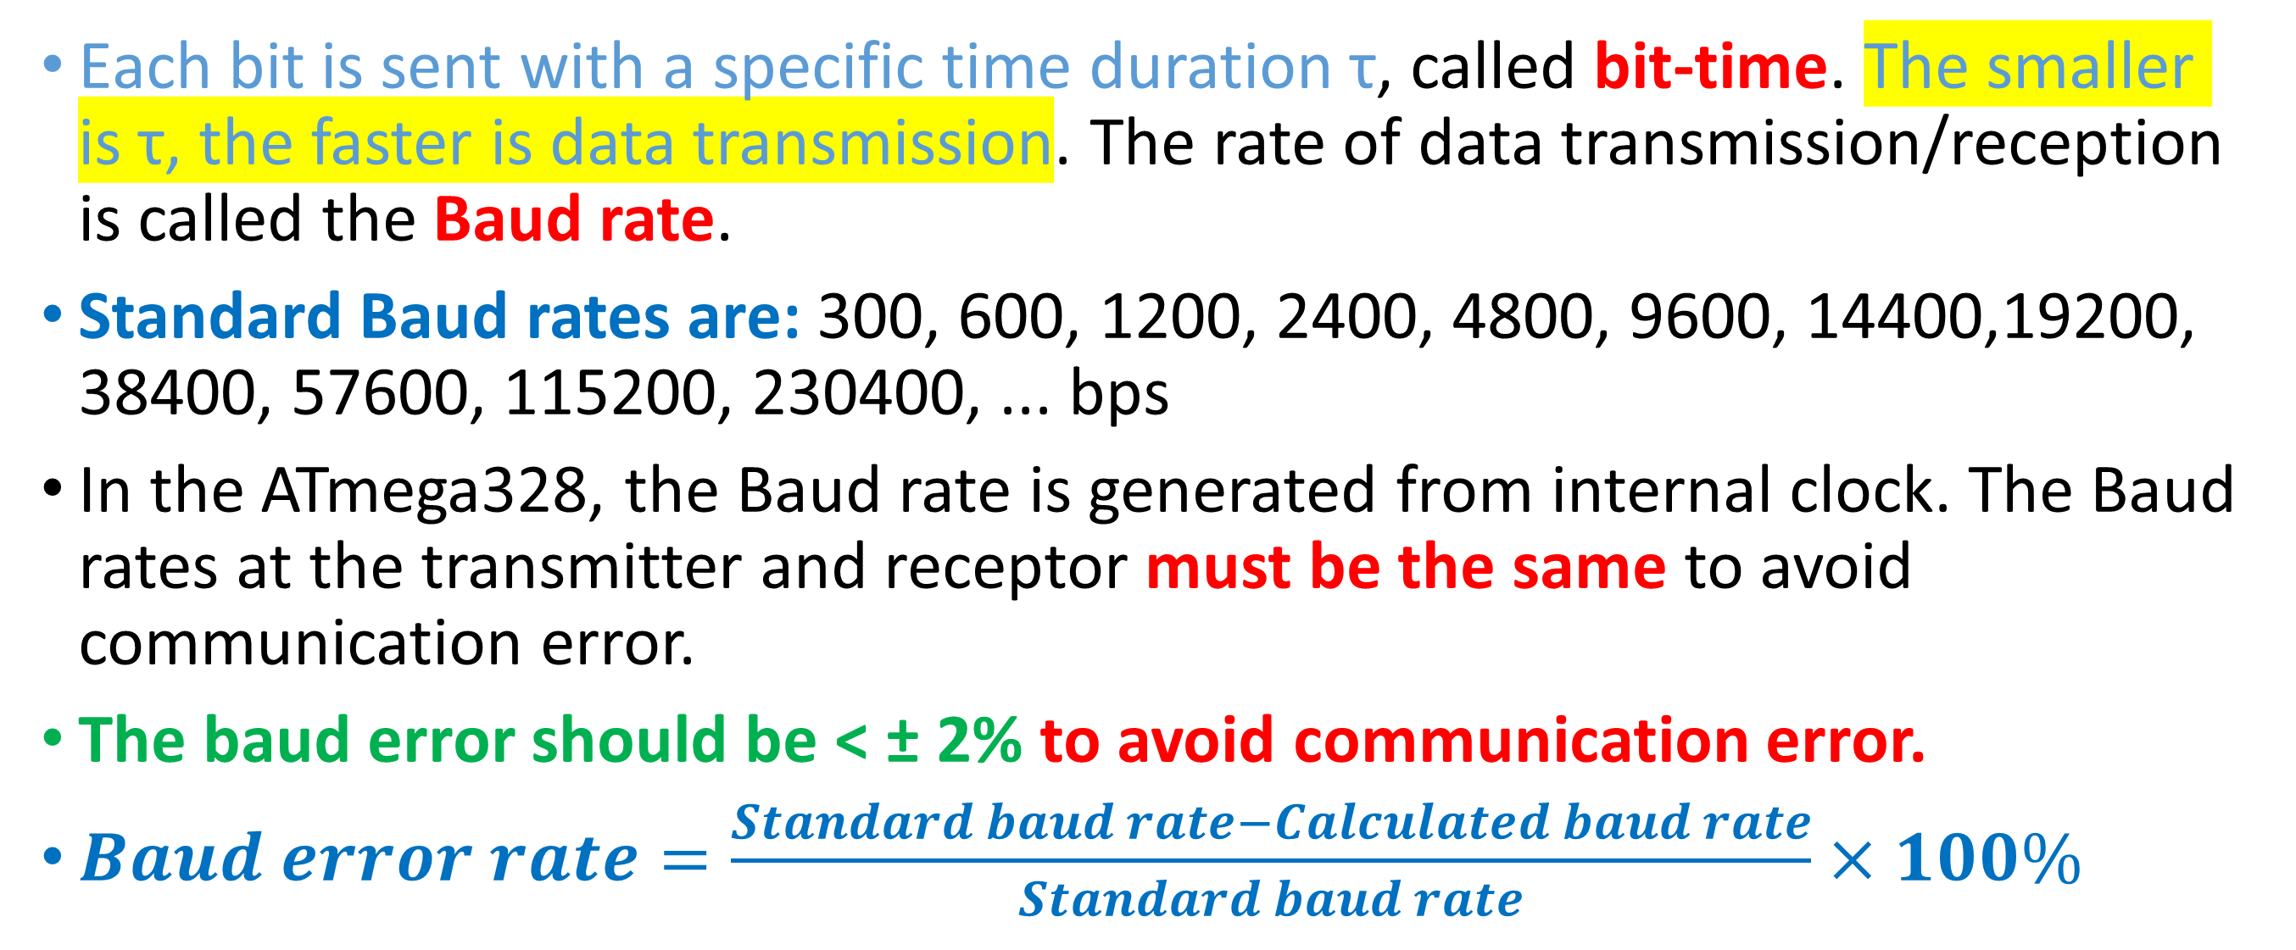
USART
Each bit is sent with a specific time duration τ, called bit-time. The smaller is τ, the faster is data transmission. The rate of data transmission/reception is called the Baud rate.
Standard Baud rates are: 300, 600, 1200, 2400, 4800, 9600, 14400,19200, 38400, 57600, 115200, 230400, ... bps
In the ATmega328, the Baud rate is generated from internal clock. The Baud rates at the transmitter and receptor must be the same to avoid communication error.
The baud error should be < ± 2% to avoid communication error.
$Baud error rate=\frac{Standard baud rate−Calculated baud rate}{Standard baud rate}×100\%$

Slide 10
USART: Internal Clock Generation – The Baud Rate Generator
Internal clock generation is used for the asynchronous and the synchronous master modes of operation.
The USART Baud Rate Register (UBRRn) and the down-counter connected to it functions as a baud rate generator.
The down-counter, running at system oscillator clock frequency (f_{osc}), is loaded with the UBRRn value, each time the counter has counted down to zero, thus a clock is generated.
The Transmitter divides the baud rate generator clock output by 2, 8, or 16 depending on mode.
The baud rate generator output is used directly by the Receiver’s clock and data recovery units.

Slide 11
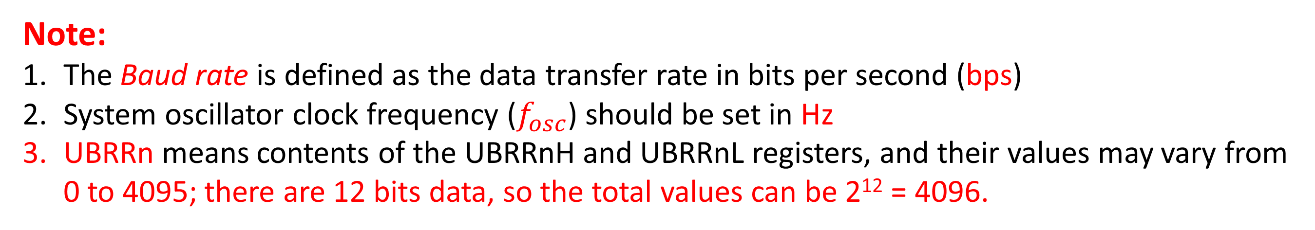
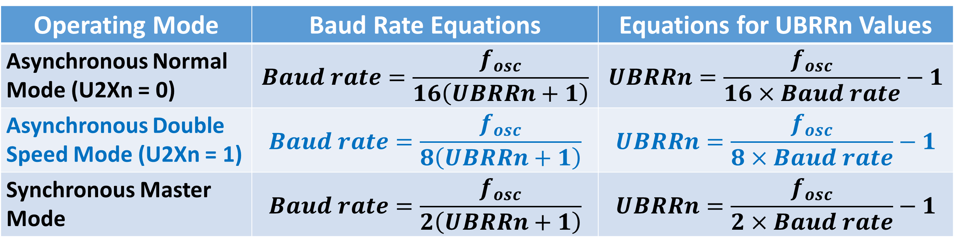
Calculation of the Baud Rate
Table 17.1 Equations to calculate Baud Rate Register Setting
Operating Mode | Baud Rate Equations | Equations for UBRRn Values
Asynchronous Normal Mode (U2Xn = 0) | $$Baud rate=\frac{f_{osc}}{16\left(UBRRn+1\right)}$$ | $$UBRRn=\frac{f_{osc}}{16×Baud rate}−1$$
Asynchronous Double Speed Mode (U2Xn = 1) | $$Baud rate=\frac{f_{osc}}{8\left(UBRRn+1\right)}$$ | $$UBRRn=\frac{f_{osc}}{8×Baud rate}−1$$
Synchronous Master Mode | $$Baud rate=\frac{f_{osc}}{2\left(UBRRn+1\right)}$$ | $$UBRRn=\frac{f_{osc}}{2×Baud rate}−1$$
Note:
The Baud rate is defined as the data transfer rate in bits per second (bps)
System oscillator clock frequency ($f_{osc}$) should be set in Hz
UBRRn means contents of the UBRRnH and UBRRnL registers, and their values may vary from 0 to 4095; there are 12 bits data, so the total values can be 2¹² = 4096.

Slide 12
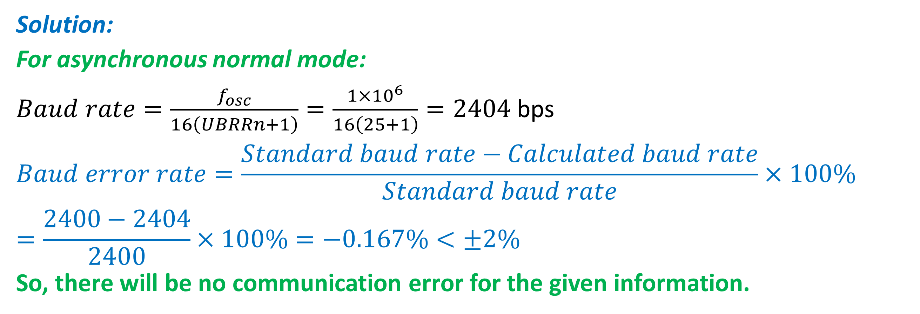
Find the baud rate for the three operating modes when f_{OSC} = 1 MHz and UBRRn = 25. Calculate the baud error and comment whether there will be any communication error or not.
Example to Practice
Solution:
For asynchronous normal mode:
$Baud rate=\frac{f_{osc}}{16\left(UBRRn+1\right)}=\frac{1×{10}^{6}}{16\left(25+1\right)}=2404$ bps
$$Baud error rate=\frac{Standard baud rate−Calculated baud rate}{Standard baud rate}×100\%=\frac{2400−2404}{2400}×100\%=−0.167\%<±2\%$$
So, there will be no communication error for the given information.

Slide 13
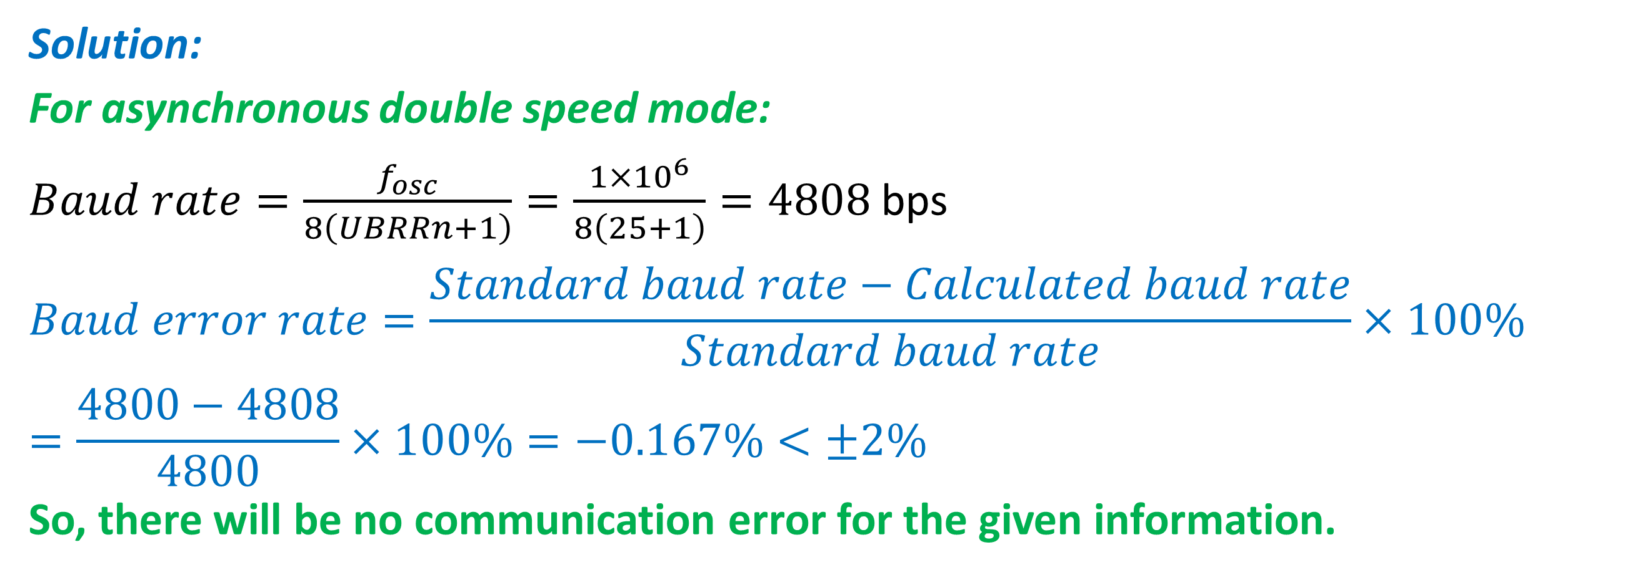
Continuation...
Solution:
For asynchronous double speed mode:
$Baud rate=\frac{f_{osc}}{8\left(UBRRn+1\right)}=\frac{1×{10}^{6}}{8\left(25+1\right)}=4808$ bps
$$Baud error rate=\frac{Standard baud rate−Calculated baud rate}{Standard baud rate}×100\%=\frac{4800−4808}{4800}×100\%=−0.167\%<±2\%$$
So, there will be no communication error for the given information.

Slide 14
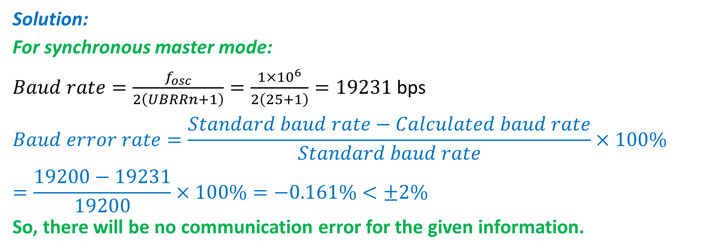
Continuation...
Solution:
For synchronous master mode:
$Baud rate=\frac{f_{osc}}{2\left(UBRRn+1\right)}=\frac{1×{10}^{6}}{2\left(25+1\right)}=19231$ bps
$$Baud error rate=\frac{Standard baud rate−Calculated baud rate}{Standard baud rate}×100\%=\frac{19200−19231}{19200}×100\%=−0.161\%<±2\%$$
So, there will be no communication error for the given information.

Slide 15
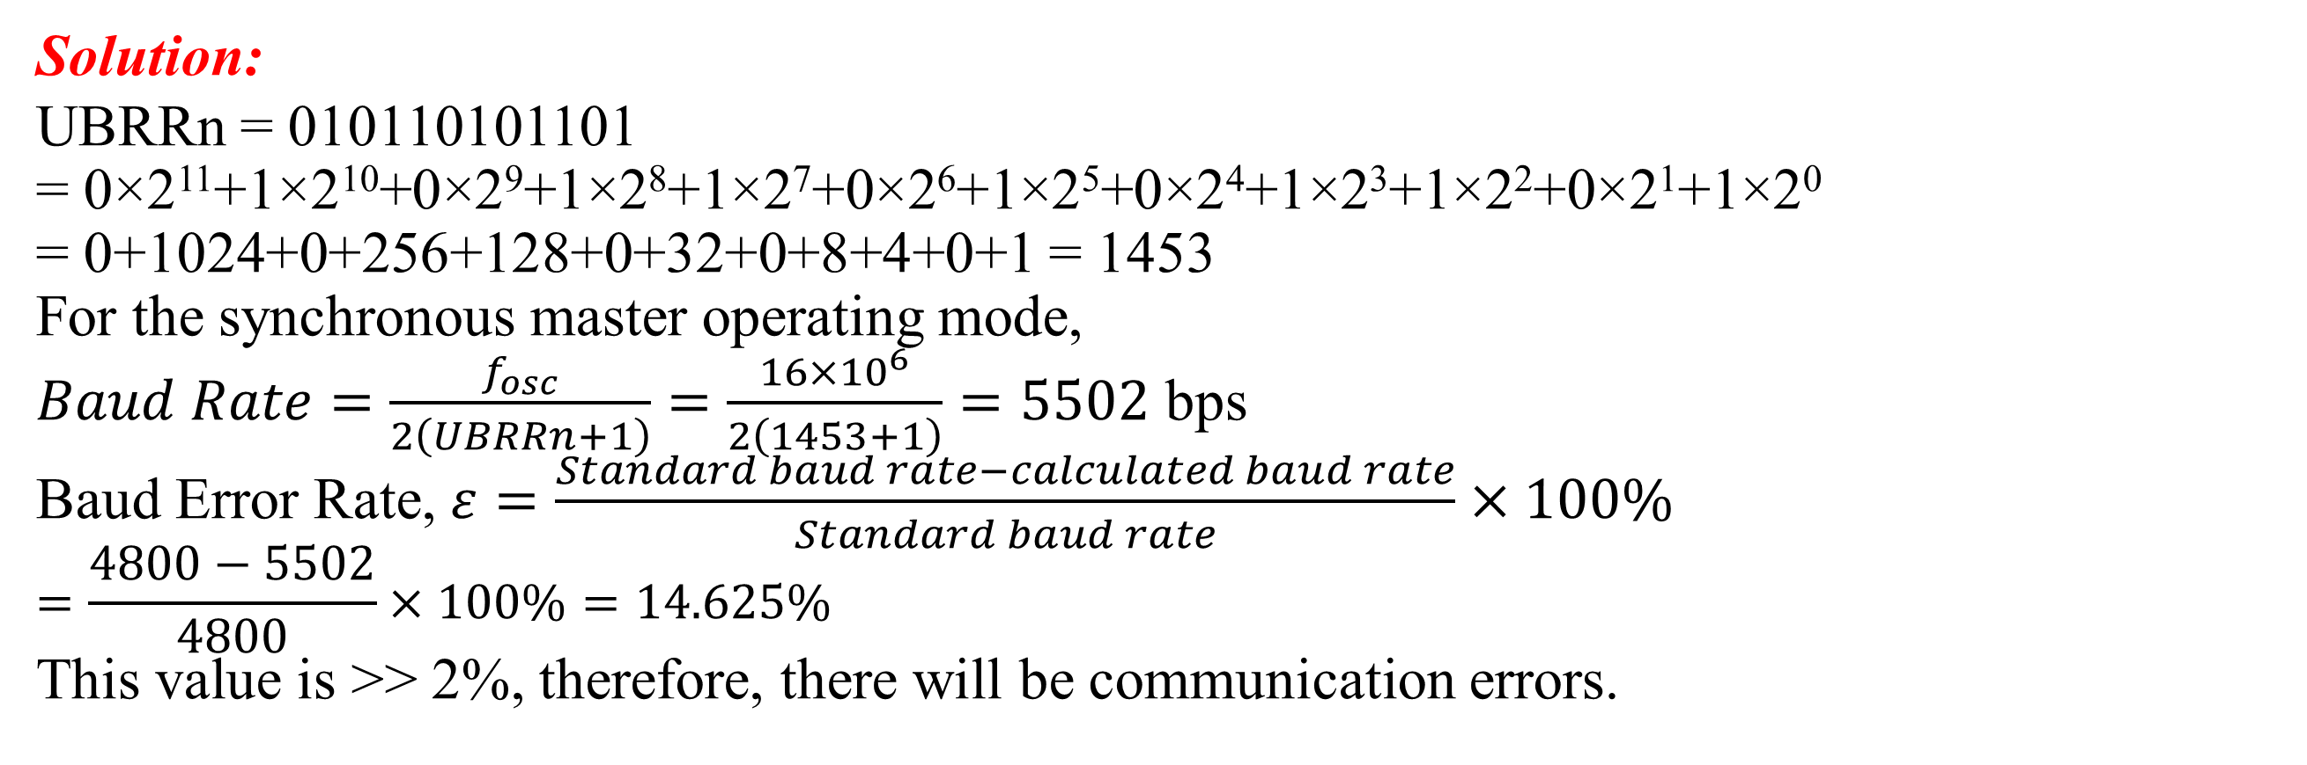
Practice Example # 1
Compute the baud rate for the synchronous master operating mode when the oscillator frequency, f_{OSC} = 16 MHz, and register data is, UBRRn = 010110101101. Compute the baud error and comment on whether there will be any communication errors. Standard Baud rates are 300, 600, 1200, 2400, 4800, 9600, 14400,19200, 38400, 57600, 115200, 230400, ... bps.
Solution:
UBRRn = 010110101101
= 0×2¹¹+1×2¹⁰+0×2⁹+1×2⁸+1×2⁷+0×2⁶+1×2⁵+0×2⁴+1×2³+1×2²+0×2¹+1×2⁰
= 0+1024+0+256+128+0+32+0+8+4+0+1 = 1453
For the synchronous master operating mode,
$Baud Rate=\frac{f_{osc}}{2\left(UBRRn+1\right)}=\frac{16×{10}^{6}}{2\left(1453+1\right)}=5502$ bps
Baud Error Rate, $ε=\frac{Standard baud rate−calculated baud rate}{Standard baud rate}×100\%$
$$=\frac{4800−5502}{4800}×100\%=14.625\%$$
This value is >> 2%, therefore, there will be communication errors.

Slide 16
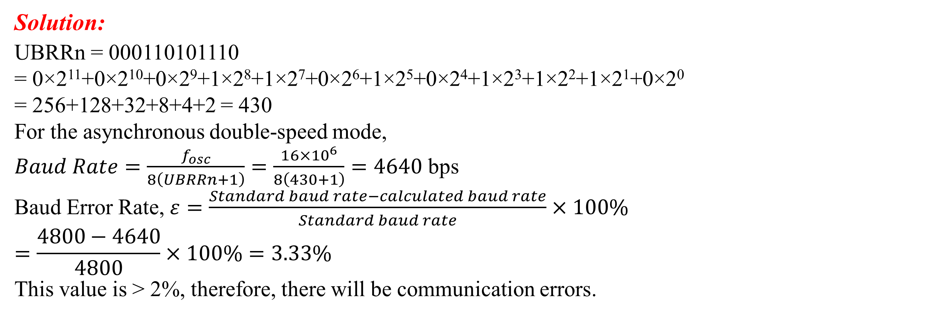
Practice Example # 2
Compute the baud rate for the asynchronous double-speed mode when the oscillator frequency, f_{OSC} = 16 MHz, and the baud rate register data is, UBRRn = 000110101110. Compute the baud error and comment on whether there will be any communication errors. Standard Baud rates are 300, 600, 1200, 2400, 4800, 9600, 14400, 19200, 38400, 57600, 115200, 230400, ... bps.
Solution:
UBRRn = 000110101110
= 0×2¹¹+0×2¹⁰+0×2⁹+1×2⁸+1×2⁷+0×2⁶+1×2⁵+0×2⁴+1×2³+1×2²+1×2¹+0×2⁰
= 256+128+32+8+4+2 = 430
For the asynchronous double-speed mode,
$Baud Rate=\frac{f_{osc}}{8\left(UBRRn+1\right)}=\frac{16×{10}^{6}}{8\left(430+1\right)}=4640$ bps
Baud Error Rate, $ε=\frac{Standard baud rate−calculated baud rate}{Standard baud rate}×100\%$
$$=\frac{4800−4640}{4800}×100\%=3.33\%$$
This value is > 2%, therefore, there will be communication errors.

Slide 17
USART- Arduino Libraries
USART functions can be used with Serial Monitor of the Arduino.
1. serial.begin(baud) – to enable input/output to serial monitor with baud speed or rate in bps. Must be written in setup().
2. serial.available() – Get the number of bytes (characters) available for reading from the serial port.
3. serial.println(val) – to display val value to serial monitor with newline added.
4. serial.print(val) – as above but without newline.
5. serial.print(“Error”) – display message “Error” without newline.
6. serial.read() – Reads incoming serial data.
For other functions – please refer to arduino.cc.

Slide 18
USART: Camera shutter speed example
This example detects how long a camera shutter is open by using a change interrupt. At the first transition, it gets the time and at the second one, it gets the new time. Then the main loop shows the difference.
This is tested down to a 50 µs pulse, but it could probably go a bit shorter, as it takes around 5 µs to enter and leave an ISR.
else
startTime = micros ();
started = !started; } // end of the shutter
void setup () {
Serial.begin (115200);
Serial.println ("Shutter test ...");
attachInterrupt (digitalPinToInterrupt (2), shutter, CHANGE);
} // end of the setup
void loop () {
if (endTime) {
Serial.print ("Shutter open for ");
Serial.print (endTime - startTime);
Serial.println (" microseconds.");
endTime = 0; } // end of if statement
} // end of the loop
volatile boolean started;
volatile unsigned long startTime;
volatile unsigned long endTime;
// interrupt service routine
void shutter () {
if (started)
endTime = micros ();

Slide 19
Advantages and Disadvantages of USART
Advantages
Hardware complexity is low.
As this is one to one connection between two devices, software addressing is not required.
Due to its simplicity, it is widely used in the devices having 9 pin connectors.
Disadvantages
It is suitable for communication between only two devices.
It supports fixed data rate between devices wanting to communicate otherwise data will be garbled (distorted ,unclear).

Slide 20
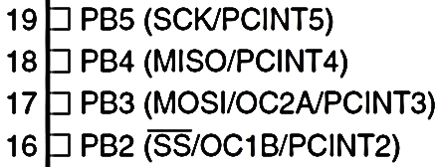
Serial Peripheral Interfaces (SPI)
SPI is a synchronous data communication.
SPI uses 4 pins in Port B:
SS/PB2 – Slave (Peripheral) Selection pin, this pin on each peripheral enables the Master to enable and disable a slave or peripheral device.
MOSI/PB3 – Master (Controller) Out Slave In, the Master line for sending data to the Peripherals, this pin enables the Master to drive a slave.
MISO/PB4 – Master In Slave Out, the Slave line for sending data to the master, this pin enables the Master to receive any slave data.
SCK/PB5 – The clock pulses which synchronize data transmission generated by the Master (Controller).

Slide 21
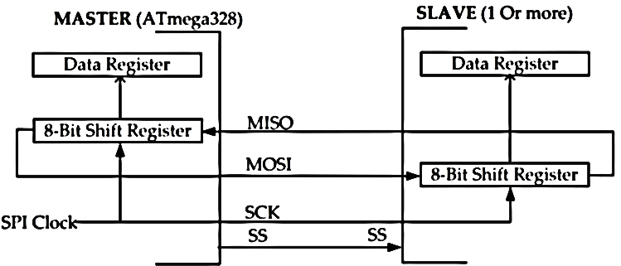
Serial Peripheral Interfaces (SPI)
Connection using SPI is in the Master-Slave configuration.
Master – Normally, is the ATmega328. Master (Controller) initiates the data transfer. SPI clock is also generated by master.
Slave – Consists of 1 or more SPI I/O Slaves (Peripherals). The slave transfers data as a reaction to master.

Slide 22
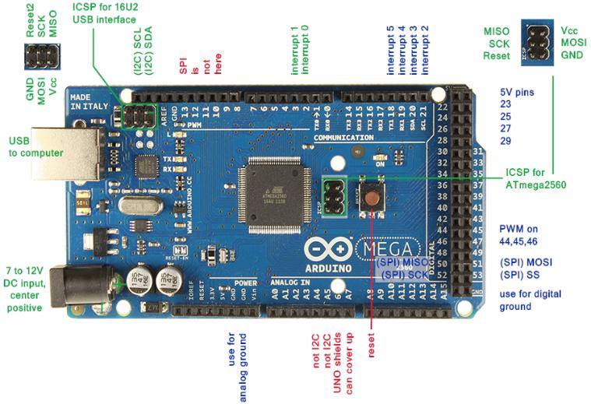
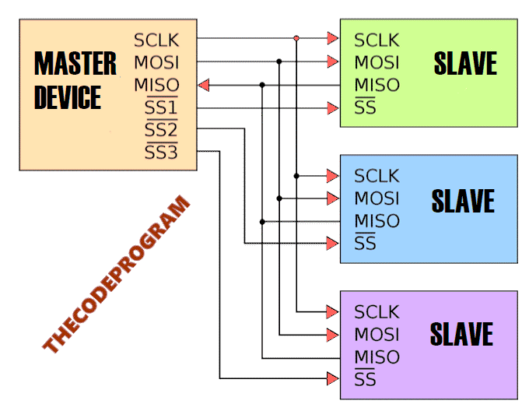
Serial Peripheral Interfaces (SPI)
Connection using SPI is in the Master (Controller)-Slave (Peripheral) configuration.
SPI Communication Schematic
SPI Communication Schematic Ports on Arduino Mega Board

Slide 23
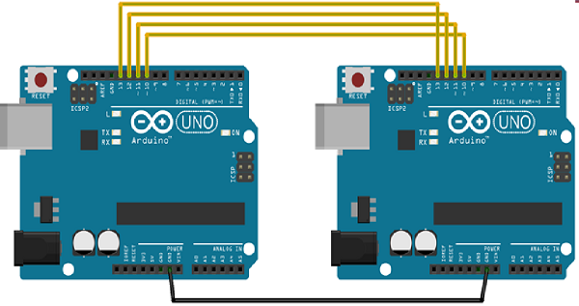
Serial Peripheral Interfaces (SPI)
Let's make an example with Arduino. In this example, we are going to let the two Arduinos to communicate with each other.
We will connect two Arduino UNO boards; one as a master and the other as a slave.
(SS): pin 10; Slave Selection
(MOSI): pin 11
(MISO): pin 12
(SCK): pin 13
Communication
Pin connections of these two Arduinos

Slide 24
SPI Arduino Libraries
SPI.begin() – Initializes the SPI bus by setting SCK, MOSI, and SS to outputs, set SCK & MOSI low, & SS high. Must be written in setup()
SPI.end() – Disables the SPI bus.
SPI.setBitOrder(order) – Sets the order of the bits shifted out of and into the SPI bus, either LSBFIRST or MSBFIRST.
SPI.setClockDivider(divider) – Sets the SPI clock divider (SPI_CLOCK_DIVn, n = 2, 4, 8, 16, 32, 64, or 128). The default setting is SPI_CLOCK_DIV4, which sets the SPI clock to 4 MHz for Uno
SPI.setDataMode(mode) – Sets the SPI data mode: clock polarity and phase. Available modes: SPI_MODE0 – SPI_MODE3. refer to arduino.cc
SPI.transfer(val) – Transfers one byte over the SPI bus, both sending and receiving. val: the byte to send out.
Returns: the byte read from the bus.
SPI.beginTransaction(SPISettings(speedMaximum, dataOrder, dataMode)) − speedMaximum is the clock, dataOrder(MSBFIRST or LSBFIRST), dataMode(SPI_MODE0, SPI_MODE1, SPI_MODE2, or SPI_MODE3).

Slide 25
SPI Examples
SPI as SLAVE
#include <SPI.h>
char buff [50];
volatile byte indx;
volatile boolean process;
void setup (void) {
Serial.begin (115200);
pinMode(MISO, OUTPUT); // have to send on master in so it set as output
SPCR |= _BV(SPE); // turn on SPI in slave mode
indx = 0; // buffer empty
process = false;
SPI.attachInterrupt(); // turn on interrupt
}
ISR (SPI_STC_vect) // SPI interrupt routine {
byte c = SPDR; // read byte from SPI Data Register
if (indx < sizeof buff) {
buff [indx++] = c; // save data in the next index in the array buff
if (c == '\r') //check for the end of the word
process = true;
}
}
void loop (void) {
if (process) {
process = false; //reset the process
Serial.println (buff); //print the array on serial monitor
indx= 0; //reset button to zero
}
}
SPI as MASTER
#include <SPI.h>
void setup (void) {
Serial.begin(115200); //set baud rate to 115200 for USART
digitalWrite(SS, HIGH); // disable Slave Select
SPI.begin ();
SPI.setClockDivider(SPI_CLOCK_DIV8);//divide the clock by 8
}
void loop (void) {
char c;
digitalWrite(SS, LOW); // enable Slave Select
// send test string
for (const char * p = "Hello, world!\r" ; c = *p; p++) {
SPI.transfer (c);
Serial.print(c);
}
digitalWrite(SS, HIGH); // disable Slave Select
delay(2000);
}

Slide 26
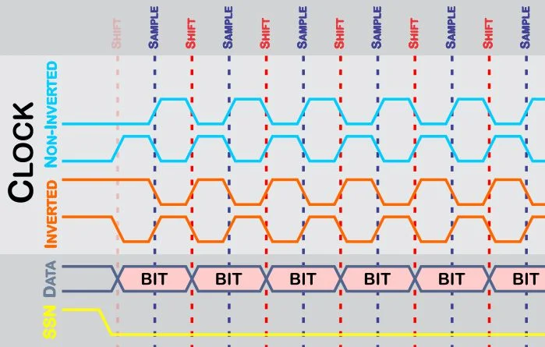
SPI Modes
There are four modes (0, 1, 2, 3) of operation in SPI. These modes correspond to the four possible clocking configurations. Clock transitions govern the shifting and sampling of data.
CPOL: Clock Polarity: This governs the initial logic state of the clock signal.
CPHA: Clock Phase: This governs the relationship between the data transitions and the clock transitions.
Mode 0
Mode 1
Mode 2
Mode 3
Bits that are sampled on the rising edge of the clock cycle are shifted out on the falling edge of the clock cycle, and vice versa.

Slide 27
SPI Modes
Each transaction begins when the slave-select line is driven to logic LOW (slave select is typically an active-LOW signal). The exact relationship between the slave-select, data, and clock lines depends on how the Clock Polarity (CPOL) and Clock Phase (CPHA) are configured.
With the Non-inverted Clock Polarity (i.e., the clock is at logic LOW when slave select transitions to logic LOW):
Mode 0 (the default) − Clock is normally LOW (CPOL = 0), and the data is sampled on the transition from LOW to HIGH (leading/rising edge) and shifted out on the trailing/falling edge of the clock pulse. (CPHA = 0).
Mode 1 − Clock is normally LOW (CPOL = 0), and the data is sampled on the transition from HIGH to LOW (trailing/falling edge) and shifted out on the (leading/ rising edge of the clock pulse (CPHA = 1).

Slide 28
SPI Modes
With the Inverted Clock Polarity (i.e., the clock is at logic HIGH when slave select transitions to logic LOW):
Mode 2 − Clock is normally HIGH (CPOL = 1), and the data is sampled on the transition from HIGH to LOW (trailing/falling edge) and shifted out on the leading/ rising edge of the clock pulse (CPHA = 0).
Mode 3 − Clock is normally HIGH (CPOL = 1), and the data is sampled on the transition from LOW to HIGH (leading/rising edge) and shifted out on the trailing/ falling edge of the clock pulse. (CPHA = 1).
SPI.attachInterrupt(handler) − Function to be called when a slave device receives data from the master.

Slide 29

SPI Hardware Structures
The SPI Control Register (SPCR) has 8 bits, each bit position may take values.
SPIE - Enables the SPI interrupt when 1
SPE - Enables the SPI when 1
DORD - Sends the data and decides the order of data: Least (LSB) and Most (MSB) Significant Bit first when 1 and 0, respectively
MSTR - Sets the Arduino in Master mode when 1, Slave mode when 0
CPOL - Sets the data clock to be idle when high if set to 1, idle when low if set to 0
CPHA - Samples the data on the clock’s falling edge when 1, rising edge when 0
SPR1 and SPR0 - Sets the SPI speed: 00 = fastest (4 MHz), 11 = slowest (250 kHz)
SPIE
SPE
DORD
MSTR
CPOL
CPHA
SPR1
SPR0

Slide 30
SPI Examples
SPI as MASTER
void loop() {
for(count=0; count<255; count++){
sendSerialData(count, SlaveSelection);
delay(2000);
}
delay(500);
}
void sendSerialData(char data, int SlaveSelection) {
//Enable slave Arduino with setting the Slave Selection pin to 0 V
digitalWrite(SlaveSelection, LOW);
// Wait for a moment
delay(10);
//We sent the data here and wait for the response from device
char receivedValue = SPI.transfer(data);
//And then write the answer to the serial port
Serial.println(receivedValue);
//Disable slave Arduino with setting the Slave Selection pin to 5 V
digitalWrite(SlaveSelection, HIGH);
}
SPI as MASTER
//SPI Master Device
//We need to import SPI.h library first
#include <SPI.h>
//Our Slave Selection pin
#define SlaveSelection 10
int count = 0;
void setup()
{
//Set SlaveSelection pin as output.
pinMode(SlaveSelection, OUTPUT); //and Make it //HIGH to prevent to start communication right away
digitalWrite(SlaveSelection, HIGH); //Start the SPI //communication.
SPI.begin();
}

Slide 31
SPI Examples
SPI as SLAVE
SPI as SLAVE
void loop()
{
delay(1000);
}
//SPI Interrupt function
ISR(SPI_STC_vect) {
//Here we read the SPI lines, this line will check data for every ASCII codes //for 8-bit received data SPDR -> SPI Data Read bit
SPDR = i;
i ++;
if ( i > 255)
i = 0;
while(!(SPSR & (1 << SPIF)));
//Load the received data to the variable
char received = SPDR;
//And send it to the serial communication bus
Serial.println(received);
}
//Slave device of the SPI communication
#include <SPI.h>
char i = 0;
#define SlaveSelection 10
void setup() {
//Start the Serial Communication
Serial.begin(9600);
// initialize SPI :
pinMode(SlaveSelection , INPUT); // Set Slave Selection as input
pinMode(13,OUTPUT); // Set clock as output
pinMode(11,OUTPUT); // Set MOSI as output
pinMode(12,INPUT); // Set MISO as input
// SPCR - SPI Control Register
// According to the structure of table we, enable the SPI and Interface
SPCR |= 0b11000000;
// SPSR - SPI Status Register
SPSR |= 0x00;
}

Slide 32
Practice Example # 1
Compute the output for 20 seconds and the SPI clock frequency when the oscillator frequency, f_{OSC} = 16 MHz for the following codes. Determine the slave state at the end of the program.
#include <SPI.h>
void setup (void) {
Serial.begin(57600);
digitalWrite(SS, HIGH);
SPI.begin();
SPI.setClockDivider(SPI_CLOCK_DIV8);
}
void loop (void) {
char c;
digitalWrite(SS, LOW);
// send test string
for (const char * p = "! \r" ; c = *p; p++) {
SPI.transfer(c); Hello, Engineers
Serial.print(c);
}
Serial.println(“+++++”);
digitalWrite(SS, HIGH);
delay(4000);
}

Slide 33
Practice Example # 1
Solution:
From the command in the code, delay(4000);
We find that the string sending repetition rate is 4 seconds per string. So, within 20 seconds, the string will be sent 20/4 = 5 times. So, the serial monitor output will look as follows:
Hello, Engineers!+++++
Hello, Engineers!+++++
Hello, Engineers!+++++
Hello, Engineers!+++++
Hello, Engineers!+++++
Since “+++++” signs are in the Serial.println() function so, the next characters will be printed on the serial monitor in a new line.
From the command in the code, Serial.begin(57600);
We find that the baud rate is 57600 bps.
From the command in the code, SPI.setClockDivider(SPI_CLOCK_DIV8);
We find that the SPI clock frequency is 16/8 = 2 MHz.
From the command in the code, digitalWrite(SS, HIGH);
We find that the slave state (SS) at the end of the program is HIGH. Therefore, the slave or controller device is deactivated after each cycle.

Slide 34
Advantages and Disadvantages of SPI
Advantages
It is a simple protocol and hence does not require processing overheads.
Supports full duplex communication.
Due to the separate use of CS lines, the same kind of multiple chips can be used in the circuit design.
SPI uses push-pull and hence higher data rates, and longer ranges are possible.
SPI uses less power compared to I2C
Disadvantages
As the number of slaves increases, the number of CS lines increases, this results in hardware complexity as the number of pins required will increase.
To add a device in SPI requires one to add an extra CS line and changes in software for the particular device addressing is concerned.
Master and slave relationship can not be changed as usually done in the I2C interface.
No flow control available in SPI.

Slide 35
I2C (Inter-Integrated Circuit): What is it?
An inter-integrated circuit (I2C) or two-wire interface (TWI) is a synchronous serial protocol originally developed by Philips Semiconductors (now NXP).
It’s a multi-master, multi-slave serial bus for low-speed devices that only requires two wires among multiple devices. It can easily be implemented with two digital input/output channels on a device.
An I2C bus has just two wires over which hundreds of devices communicate serially.
As a master-slave type communication standard, at least one device connected to the bus should be the master that generates a clock signal for synchronous serial data communication.
The slave devices can transfer data to and from the master device(s), which access slave devices by their I2C addresses. The address of each slave device on an I2C bus must be unique. The I2C slave devices still must obtain their addresses from NXP.

Slide 36
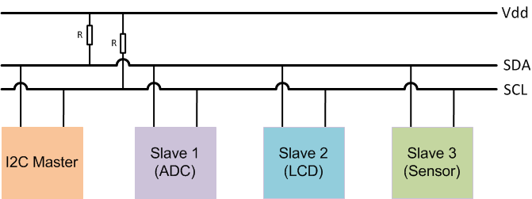
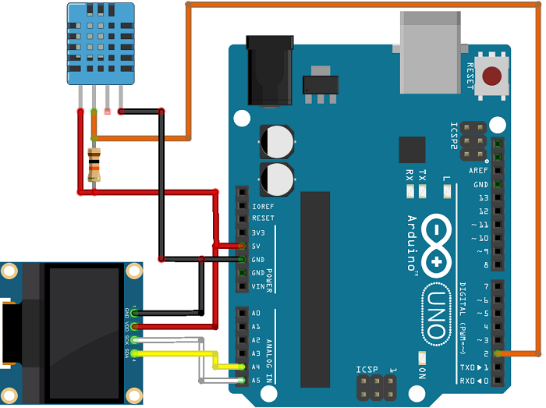
I2C (Inter-Integrated Circuit)
A chip-to-chip protocol for communicating with low-speed peripherals.
The I2C bus drivers are open drain, which means the devices can pull the I2C signal line low but cannot drive it high. By default, both the lines are pulled high by pull-up resistors until the bus is accessed by a master device to avoid bus contention.
DHT Sensor (Slave1)
SDA Pin | A4 Pin
SCL Pin | A5 Pin
Arduino (Master)
OLED (Slave2)
Block Diagram of an I2C protocol for communicating with multiple low-speed peripheral devices (Slaves) using a single controller device (Master)

Slide 37
I2C (Inter-Integrated Circuit)
I2C is another serial protocol for two-wire interface to connect to low-speed devices like Micro-controller, EEPROMs, I/O Interfaces, and other similar devices used in embedded systems.
I2C is a bus for communication between a master (or can be multiple masters) and a single or multiple slave devices.
I2C uses only two wires- SCL (Serial Clock) and SDA (Serial Data).
SCL (Serial Clock): The clock line used to synchronize all data transfers over the I2C bus, the line over which master device(s) generate the clock signal.
SDA (Serial Data): The data line used to transmit the data between devices, the line over which the master and slave devices communicate serial data
Each I2C Slave devices have a 7-bit/10-bit addressing.
The data transfer rate depends on the clock frequency. In the standard mode, the clock frequency is 100-400 kHz with 7 bit addressing and data transfer of 100 kbps.

Slide 38
I2C Addresses
The clock frequencies for the following three modes are with 10-bit addressing:
1 MHz in fast mode I2C (data rate 400 kbps)
3.4 MHz in high-speed mode (data rate 1 Mbps)
5 MHz in ultra-fast mode (data rate 3.4 Mbps)
Addresses need to be unique on the bus to determine the slave that were to transmit the data.
The master device needs no address since it generates the clock (using SCL) and addresses individual I2C Slave devices.
The maximum number of Slave devices that can be used while using 7-bit addressing are 112 devices The I2C specification has reserved 2 sets of 8 addresses, 1111XXX and 0000XXX. and the maximum number of Slave devices used in 10-bit addressing are 1008 devices. The remaining 16 are reserved.
Extension to standard mode I2C

Slide 39
Working of I2C in Arduino
The I2C is a half-duplex type of communication. A master (controller) device can only read or write data to the slave (peripheral) at a time. All operations are controlled by master device(s).
In I2C data transfer occurs in Message Frames which are then divided into Frames of Data. A message contains the various number of Frames in which one frame contain the address of the slave, and remaining frames for data to be transmitted.
In the I2C protocol, writing to and reading from the target (peripheral/slave) device requires the use of an I2C address. The I2C address identifies which device the controller (master) wants to communicate with. Typically, this address is written over a single byte, where the address itself is 7 bits, and an eighth additional bit is used to indicate a read from or write to the device.
The message includes START/STOP Conditions, READ/WRITE Bits, Address Bits, ACK/NACK (Acknowledgement/No-acknowledgement) Bits, and Data Bits between each Frame of Data.
Working sequence described in the following slides:

Slide 40
Working of I2C in Arduino
Start Condition: The SDA line switches from high to low voltage level before SCL switches from high to low.
Stop Condition: The SDA line switches from low to high voltage level after SCL switches from low to high.
Address Frame: 7 or 10-bit sequence unique to each slave that identifies the slave when the master wants to talk.
Read/Write Bit: A bit specifying whether the master is sending data to the slave or requesting data from it.
ACK/NACK Bit: Each frame in a message follows an ACK/NACK Bit.
7-bit Addressing:
In 7-bit addressing procedure, the slave address is transferred in the first byte after the Start condition. The first seven bits of the byte comprise the slave address. The eighth bit is the read/write flag where 0 indicates a write and 1 indicates a read.

Slide 41

Working of I2C in Arduino
Figure 1: 7-bit addressing. The I2C bus specification specifies that in standard-mode I2C, the slave address is 7-bits long followed by the read/write bit.
All I2C products from Total Phase, follow this standard convention. The slave address used should only be the top seven bits. In the case of the Aardvark I2C/SPI Host Adapter, the software will automatically append the correct read/write bit depending on the transaction to be performed. In the case of the Beagle I2C/SPI Protocol Analyzer, the slave address and the type of transaction are displayed in two different columns.
Reserved Addresses
The I2C has several sets of reserved addresses that are limited for use based on specific applications. The functions called with these reserved addresses are options for devices and are not necessarily available in all I2C devices. The I2C’s specific reserved two sets of eight addresses are 1111XXX and 0000XXX. These addresses are used for special purposes.

Slide 42
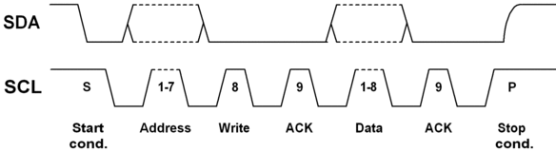
Working of I2C in Arduino
Figure 1: 7-bit addressing. The I2C bus specification specifies that in standard-mode I2C, the slave address is 7-bits long followed by the read/write bit.
The first byte of an I2C transfer contains the slave address and the data direction.
The address is 7 bits long, followed by the direction bit (read or write operation). Like all data bytes, the address is transferred with the most significant bit first.

Slide 43
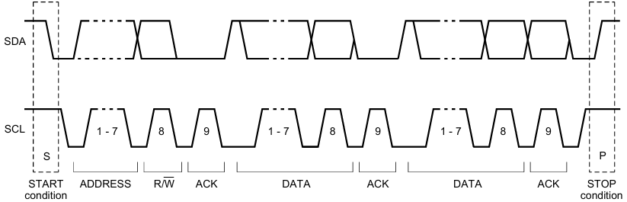
Working of I2C in Arduino
Data transfers follow the format shown in Fig. 2. After the START condition (S), a target address is sent. This address is seven bits long followed by an eighth bit which is a data direction bit (R/W), a ‘0’ indicates a transmission of data (WRITE), a ‘1’ indicates a request for data (READ).
A data transfer is always terminated by a STOP condition (P) generated by the controller. However, if a controller still wishes to communicate on the bus, it can generate a repeated START condition (Sr) and address another target without first generating a STOP condition. Various combinations of read/write formats are then possible within such a transfer.
The total number of bits transferred in frame one is 7 + 1 + 1 + 8 + 1 = 18.
If the clock frequency is 200 kHz with 7 bit addressing mode, the clock period is 1/200 ms = 5 μs. Thus, the data transfer time = 18⨯5 = 90 μs.
So, the data transfer rate is 18⨯10⁶/90 = 200 kbps.
The frame rate is 10⁶/90 ≅ 11 kfps.
Figure 2: A complete data transfer.

Slide 44
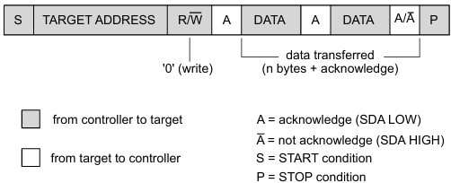
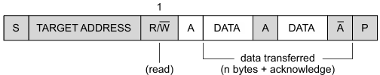
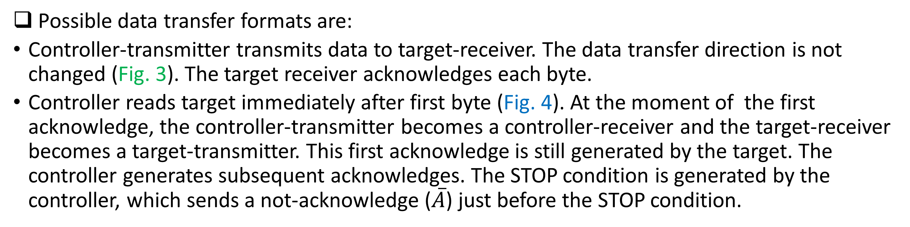
Working of I2C in Arduino
Possible data transfer formats are:
Controller-transmitter transmits data to target-receiver. The data transfer direction is not changed (Fig. 3). The target receiver acknowledges each byte.
Controller reads target immediately after first byte (Fig. 4). At the moment of the first acknowledge, the controller-transmitter becomes a controller-receiver and the target-receiver becomes a target-transmitter. This first acknowledge is still generated by the target. The controller generates subsequent acknowledges. The STOP condition is generated by the controller, which sends a not-acknowledge ($\overline{A}$) just before the STOP condition.
Figure 4: A controller reads a target immediately after the first byte.
Figure 3: A controller-transmitter addressing a target receiver with a 7-bit address (the transfer direction is not changed).

Slide 45
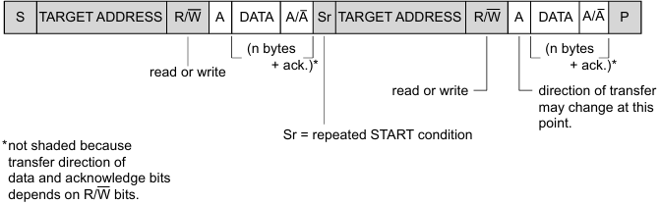
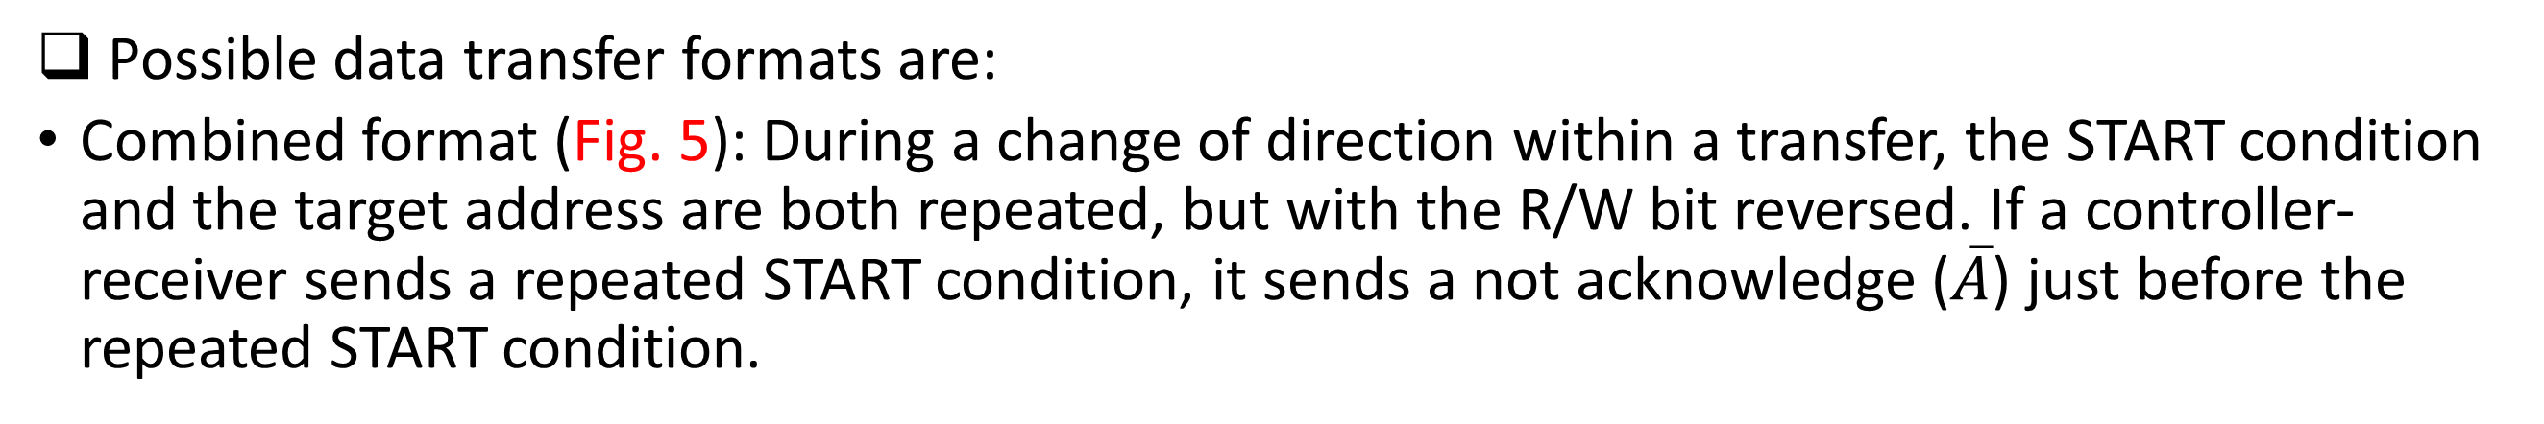
Working of I2C in Arduino
Possible data transfer formats are:
Combined format (Fig. 5): During a change of direction within a transfer, the START condition and the target address are both repeated, but with the R/W bit reversed. If a controller-receiver sends a repeated START condition, it sends a not acknowledge ($\overline{A}$) just before the repeated START condition.
Combined formats can be used, for example, to control a serial memory. The internal memory location must be written during the first data byte. After the START condition and target address is repeated, and data can be transferred.
Each byte is followed by an acknowledgment bit as indicated by the A or A blocks in the sequence.
Figure 5: A controller-transmitter and a target-receiver both are exchanging data.

Slide 46
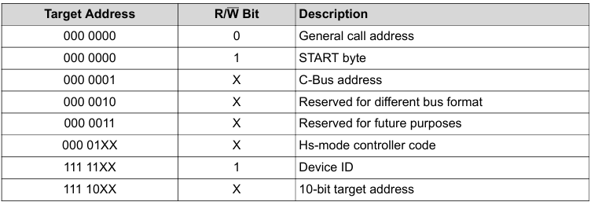
Working of I2C in Arduino
The following table has been taken from the I2C Specifications (2000).
List of Reserved I2C addresses
(1) No device is allowed to acknowledge at the reception of the START byte.
(2) The CBUS address has been reserved to enable the inter-mixing of CBUS compatible and I2C-bus compatible devices in the same system. I2C-bus compatible devices are not allowed to respond on reception of this address.
(3) The address reserved for a different bus format is included to enable I2C and other protocols to be mixed. Only I2C-bus compatible devices that can work with such formats and protocols are allowed to respond to this address.

Slide 47

Working of I2C in Arduino
10-bit Addressing
One of the reasons that Total Phase decided to use 7-bit addressing for all of its products was to ensure that 10-bit addressing could be properly handled.
10-bit addressing was designed to be compatible with 7-bit addressing, allowing developers to mix two types of devices on a single bus. When communicating with a 10-bit addressed device, the special reserved address is used to indicate that 10-bit addressing is being used.
Figure 6: 10-bit addressing. In 10-bit addressing, the slave address is sent in the first two bytes. The first byte begins with the special reserved address of 1111 0XX which indicates that 10-bit addressing is being used. The 10 bits of the address is encoded in the last 2 bits of the first byte and the entire 8 bits of the second byte. The 8th bit of the first byte remains the read/write flag.

Slide 48
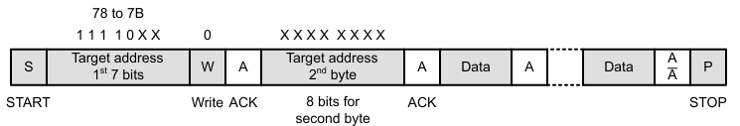
Working of I2C in Arduino
10-bit Addressing (Data Write)
Figure 7 shows the protocol to writing to a device that supports 10-bit addressing. At the beginning of a 10-bit address write, the controller sends a START condition, then, the first byte is sent with the reserved address for 10-bit I2C addressing and is followed by a 0 for a write. The reserved address last two bits includes the first two bits of the 10-bit address. At this point there can be multiple targets that have the same first address byte for 10-bit addressing, so multiple devices can acknowledge (ACK) this address. The second byte includes the target address. This byte is the eight least significant bits of the 10-bit target address.
With the second byte, there is presumably only one device with the unique 10-bit address. This is the only device that ACKs the communication.
This target stays in communication until the controller sends a STOP condition or until the controller sends a repeated START condition to communicate with a different target address.
Figure 7: I2C 10-bit addressing write.

Slide 49
Working of I2C in Arduino
10-bit Addressing (Data Read)
Reading from a 10-bit addressed device is like a write but with added steps. At the beginning of the communication, there is a START followed by the reserved address. A 0 for a write bit is then written. This is followed by an ACK from all devices that use the reserved address. The target address second byte is then sent. An ACK from the addressed device is then received. Until this point, the communication is the same as a 10-bit address write (Fig. 8).
To read from this device, the controller then sends a repeated START. This step is followed by the reserved address that was just used. Then the read bit is sent followed by an ACK. Because the read bit is sent (and not the write bit), the device that previously ACKed this communication interprets that this is a read. Other devices with the same reserved address do not respond. The addressed device then ACKs this repeat of the reserved target address.

Slide 50
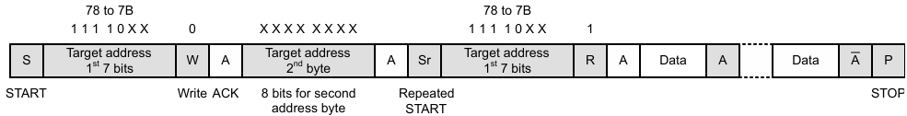
Working of I2C in Arduino
10-bit Addressing (Data Read)
After the addressed device sends the ACK, data is transmitted by the device, and after each byte, the controller ACKs the data. This data transmission continues until the controller sends a STOP condition or a repeated START followed by a different target address (Fig. 8).
Figure 8: I2C 10-bit addressing read.

Slide 51
Program for I2C: I2C_SCANNER
#include <Wire.h>
void setup()
{
Wire.begin();
serial.begin(9600);
while (!Serial); // Leonardo: wait for serial monitor
serial.println("\nI2C Scanner");
}
void loop()
{
byte error, address;
int nDevices;
serial.println("Scanning...");
nDevices = 0;
for(address = 1; address < 127; address++ )
{
// The i2c_scanner uses the return value of the
// Write.endTransmission to see if a device did acknowledge to
// the address.
Wire.beginTransmission(address);
error = Wire.endTransmission();
if (error == 0)
{
serial.print("I2C device found at address 0x");
if (address<16)
serial.print("0");
serial.print(address, HEX);
serial.println(" !");
nDevices++;
}

Slide 52
Program for I2C: I2C_SCANNER
else if (error==4)
{
serial.print("Unknown error at address 0x");
if (address<16)
serial.print("0");
serial.print(address,HEX);
serial.println(" !");
}
}
if (nDevices == 0)
serial.println("No I2C devices found\n");
else
serial.println("done\n");
delay(5000); // wait 5 seconds for next scan
}
Find addresses of different I2C devices connected to Arduino
https://playground.arduino.cc/Main/I2cScanner/

Slide 53
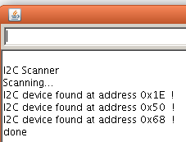
Serial Monitoring
Upload it to the Arduino and open the serial monitor. Every found device on the I2C-bus is reported.
You can change the wires, and plug-in I2C devices while the I2C_scanner is running.
The output of the serial monitor looks like this:

Slide 54
Practice Example # 1
Draw the timing waveforms for the following data transfer structure using a 7-bit addressing I2C protocol. Compute the amount of data being transferred, data transfer rate, and frame rate. The operating frequency is 100 kHz.
Solution:
The timing waveform is given below:

Slide 55
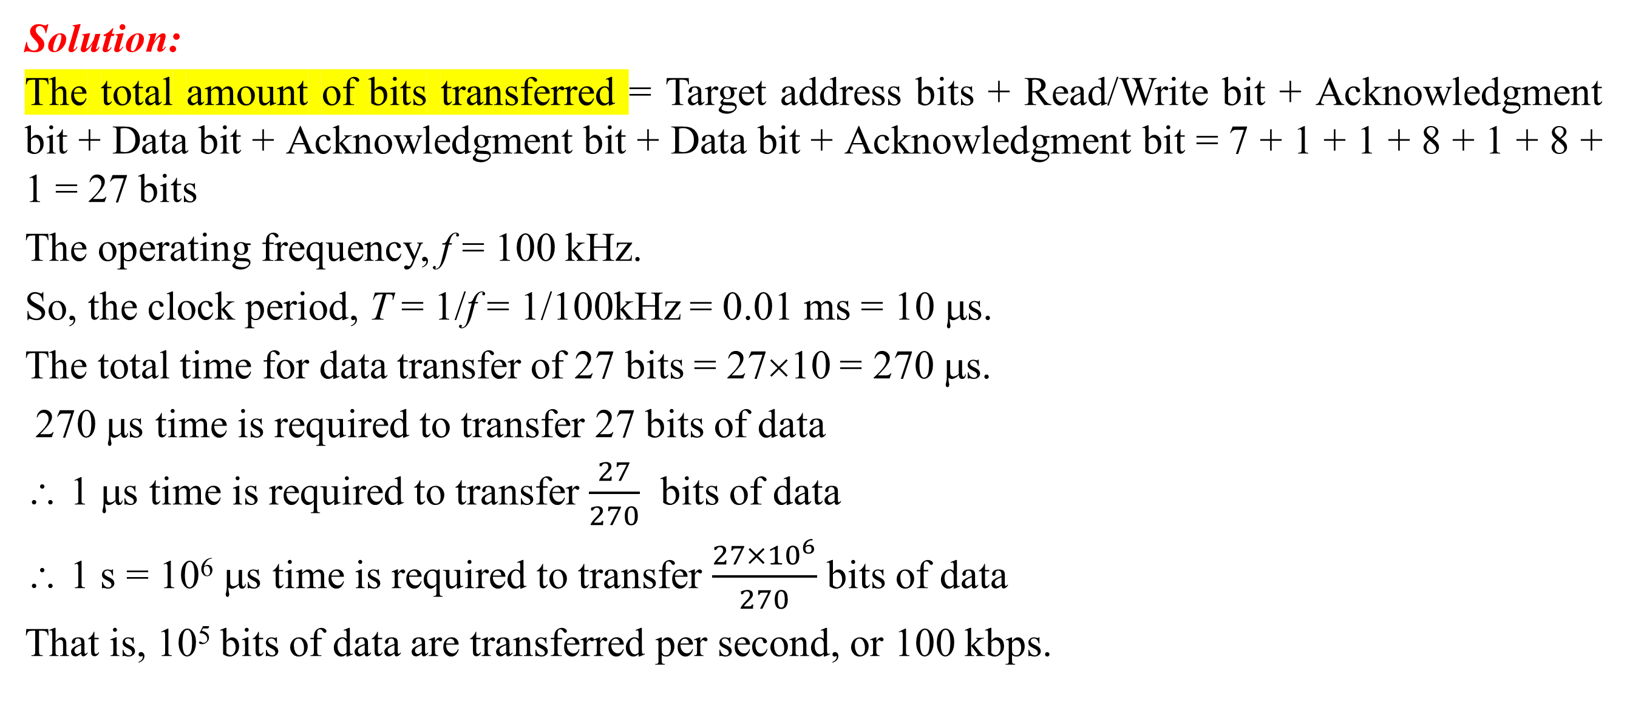
Practice Example # 1
Solution:
The total amount of bits transferred = Target address bits + Read/Write bit + Acknowledgment bit + Data bit + Acknowledgment bit + Data bit + Acknowledgment bit = 7 + 1 + 1 + 8 + 1 + 8 + 1 = 27 bits
The operating frequency, f = 100 kHz.
So, the clock period, T = 1/f = 1/100kHz = 0.01 ms = 10 μs.
The total time for data transfer of 27 bits = 27×10 = 270 μs.
270 μs time is required to transfer 27 bits of data
∴ 1 μs time is required to transfer $\frac{27}{270}$ bits of data
∴ 1 s = 10⁶ μs time is required to transfer $\frac{27×{10}^{6}}{270}$ bits of data
That is, 10⁵ bits of data are transferred per second, or 100 kbps.

Slide 56
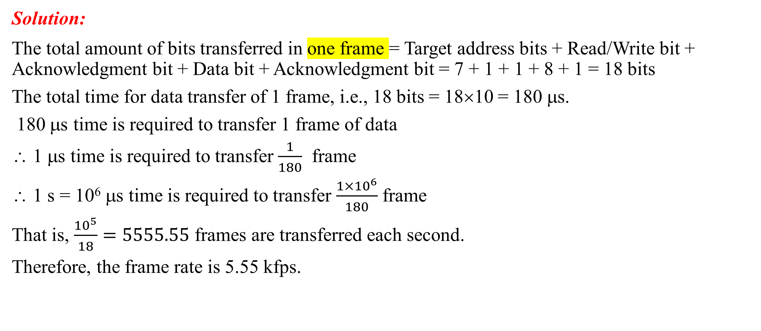
Practice Example # 1
Solution:
The total amount of bits transferred in one frame = Target address bits + Read/Write bit + Acknowledgment bit + Data bit + Acknowledgment bit = 7 + 1 + 1 + 8 + 1 = 18 bits
The total time for data transfer of 1 frame, i.e., 18 bits = 18×10 = 180 μs.
180 μs time is required to transfer 1 frame of data
∴ 1 μs time is required to transfer $\frac{1}{180}$ frame
∴ 1 s = 10⁶ μs time is required to transfer $\frac{1×{10}^{6}}{180}$ frame
That is, $\frac{{10}^{5}}{18}=5555.55$ frames are transferred each second.
Therefore, the frame rate is 5.55 kfps.

Slide 57
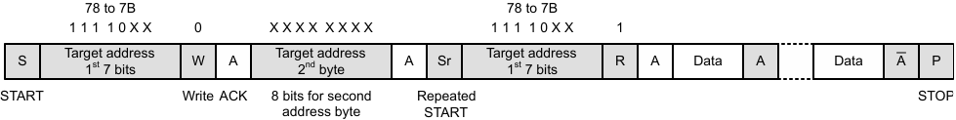
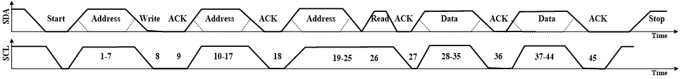
Practice Example # 2
Draw the timing waveforms for the following data transfer structure using a 10-bit addressing I2C protocol. Compute the amount of data being transferred, data transfer rate, and frame rate. The operating frequency is 5 MHz.
Solution:
The timing waveform is given below:

Slide 58
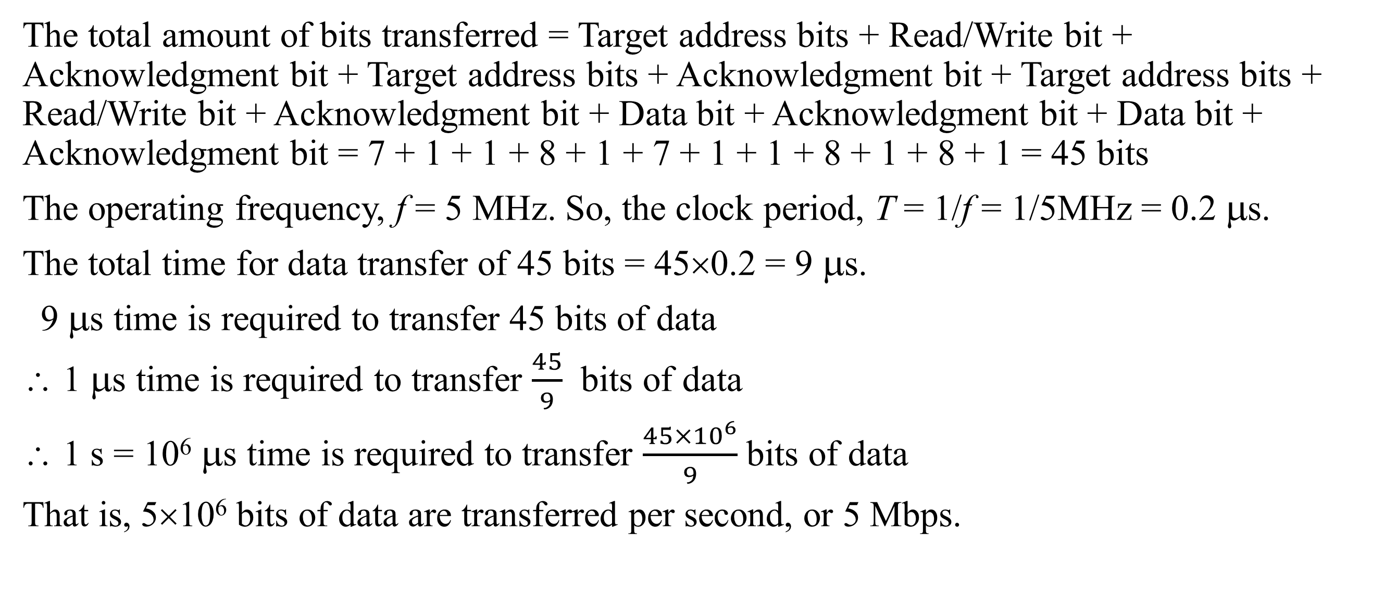
Practice Example # 2
The total amount of bits transferred = Target address bits + Read/Write bit + Acknowledgment bit + Target address bits + Acknowledgment bit + Target address bits + Read/Write bit + Acknowledgment bit + Data bit + Acknowledgment bit + Data bit + Acknowledgment bit = 7 + 1 + 1 + 8 + 1 + 7 + 1 + 1 + 8 + 1 + 8 + 1 = 45 bits
The operating frequency, f = 5 MHz. So, the clock period, T = 1/f = 1/5MHz = 0.2 μs.
The total time for data transfer of 45 bits = 45×0.2 = 9 μs.
9 μs time is required to transfer 45 bits of data
∴ 1 μs time is required to transfer $\frac{45}{9}$ bits of data
∴ 1 s = 10⁶ μs time is required to transfer $\frac{45×{10}^{6}}{9}$ bits of data
That is, 5×10⁶ bits of data are transferred per second, or 5 Mbps.

Slide 59
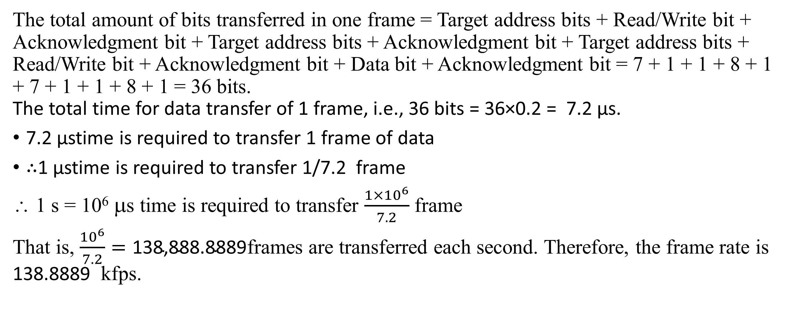
Practice Example # 2
The total amount of bits transferred in one frame = Target address bits + Read/Write bit + Acknowledgment bit + Target address bits + Acknowledgment bit + Target address bits + Read/Write bit + Acknowledgment bit + Data bit + Acknowledgment bit = 7 + 1 + 1 + 8 + 1 + 7 + 1 + 1 + 8 + 1 = 36 bits. The total time for data transfer of 1 frame, i.e., 36 bits = 36×0.2 = 7.2 μs.
7.2 μstime is required to transfer 1 frame of data
∴1 μstime is required to transfer 1/7.2 frame
∴ 1 s = 10⁶ μs time is required to transfer $\frac{1×{10}^{6}}{7.2}$ frame
That is, $\frac{{10}^{6}}{7.2}=\text{138,888.8889}$frames are transferred each second. Therefore, the frame rate is 138.8889 kfps.

Slide 60
Advantages and Disadvantages of I2C
Advantages
Due to open collector design, limited slew rates can be achieved.
More than one masters can be used in the electronic circuit design.
Needs fewer i.e., only 2 wires for communication.
I2C addressing is simple which does not require any CS lines used in SPI and it is easy to add extra devices on the bus.
It uses open collector bus concept. Hence there is bus voltage flexibility on the interface bus.
Uses flow control.
Disadvantages
Increases complexity of the circuit when number of slaves and masters increases.
I2C interface is half duplex.
Requires software stack to control the protocol and hence it needs some processing overheads on microcontroller/ microprocessor

Slide 61
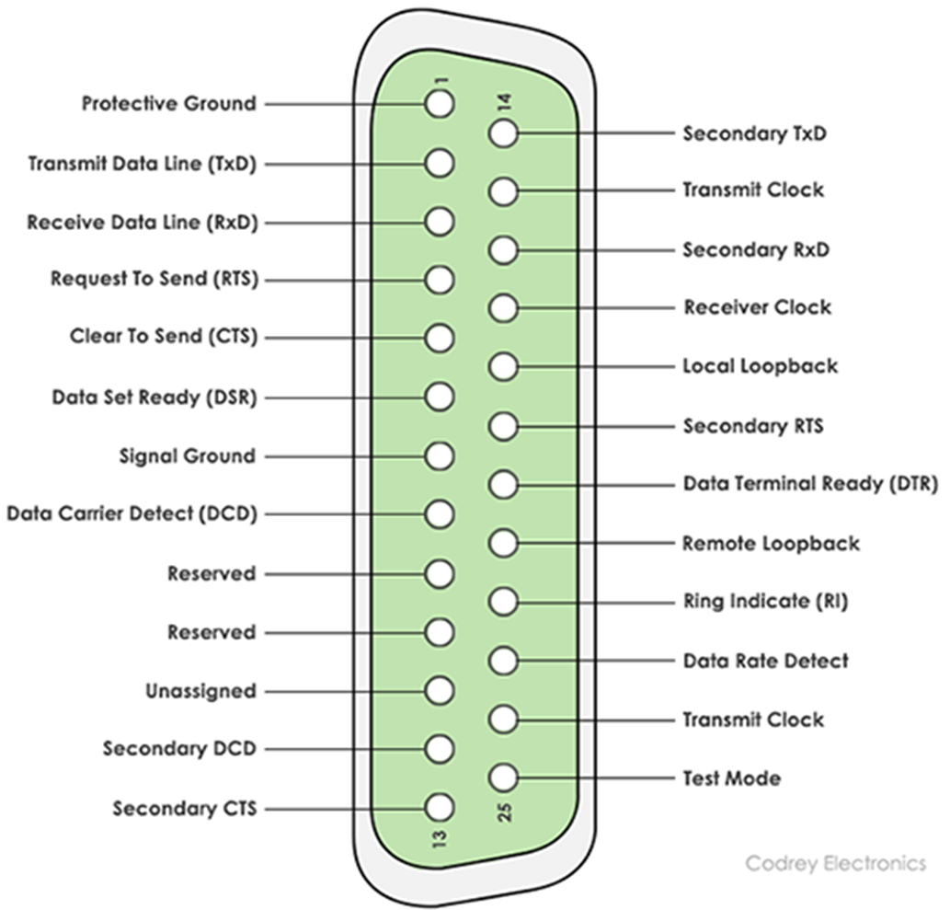
RS232
RS232 is the interface mainly used for serial data communication.
It supports data transfer rate from about 110 bps to about 115200 bps.
Hyper terminal is the application mainly used to check serial communication port of the computer, often referred as COM port.
The interface is of two types-
DB9 pin connector and
DB25 pin connector.
The interface is mainly used for one-to-one serial communication.
DB25: 25 pin connectors

Slide 62
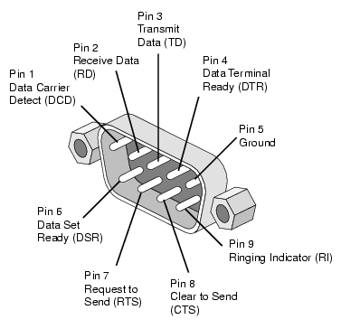
RS232
DB9: 9 pin connectors

Slide 63
Summary
The UART is good for basic, full-duplex data communication between two devices with a similar clock.
An SPI is good for full-duplex, high-speed data communication with two or more peripherals (slave) with a single controller (master) device.
An I2C is good for slow-speed data communication with multiple devices, among multiple masters over a 2-wire bus, but it is a half-duplex communication channel.

Slide 64
Thanks for attending….
?

